Slide 1
Analysis of Recursive Algorithms

Slide 2
Two Phases of Analysis
Create a formula relating input size (n) to number of basic operations.
Formally prove that formula from step 1 belongs to a particular asymptotic class, Θ(n).

Slide 3
Recursive Algorithms

Slide 4
Recursive Algorithms
Classic Example: factorial
Factorial(n)
if n = 0
return 1
else
return Factorial(n-1) * n
What is input size?
What is the basic operation?

Slide 5
Recursive Algorithms
Classic Example: factorial
Factorial(n)
if n = 0
return 1
else
return Factorial(n-1) * n
Input size: n (not number of bits)
Number of mults: M(n) = M(n-1) + 1 for n > 0
M(n) implicitly based on n – recurrence relations
Want to find M(n) as explicit function of n
Covered in COMP 47

Slide 6
Recursive Algorithms
Solving Recurrence Relations through backward substitutions:
M(n) = M(n-1) + 1
= [M(n-2) + 1] + 1 = M(n-2) + 2
= [M(n-3) + 1] + 1 + 1 = M(n-3) + 3
…
= M(n-i) + i
What happens when i = n?

Slide 7
Recursive Algorithms
Solving Recurrence Relations through backward substitutions:
M(n) = M(n-1) + 1
= [M(n-2) + 1] + 1 = M(n-2) + 2
= [M(n-3) + 1] + 1 + 1 = M(n-3) + 3
…
= M(n-n) + n
= M(0) + n
What is M(0)?

Slide 8
Recursive Algorithms
Solving Recurrence Relations through backward substitutions:
M(n) = M(n-1) + 1
= [M(n-2) + 1] + 1 = M(n-2) + 2
= [M(n-3) + 1] + 1 + 1 = M(n-3) + 3
…
= M(n-n) + n
= M(0) + n = 0 + n
= n

Slide 9
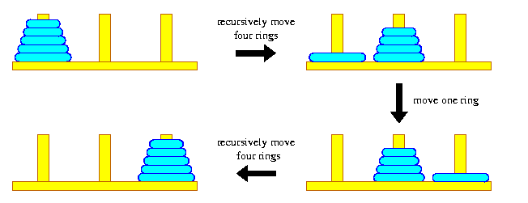
Your Turn: Tower of Hanoi
Approach to move n rings to final peg:
recursively move n-1 rings to spare peg
move last ring to final peg
recursively move n-1 rings to final peg

Slide 10
Takeaway
“One should be careful with recursive algorithms because their succinctness may mask their inefficiency.”

Slide 11
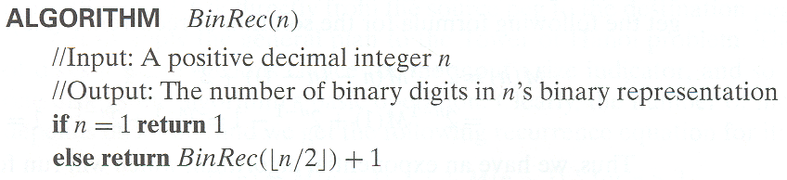
Another Example: Binary Rep
Smoothness Rule: assume n is power of 2, i.e. 2^{k}, and determine time complexity and assume that same complexity class holds for all values of n.

Slide 12
When to Use …
Summation: non-recursive function
Recurrence Relation: recursive function

Slide 13
Assignment
Lab 4
HW 2 assigned

